Slide 1
Data File Handling in C++
https://www.youtube.com/watch?v=EejEQCgxIKM&list=PLoSDia_xPJ5qFeeU_cQLBgfJiJdaZJBkk

Slide 2
Introduction
Computer programs are associated to work with files as it helps in storing data & information permanently.
File - itself a bunch of bytes stored on some storage devices.
In C++ this is achieved through a component header file called fstream.h
The I/O library manages two aspects- as interface and for transfer of data.
The library predefine a set of operations for all file related handling through certain classes.

Slide 3
Contd…
Earlier, only two streams are being used such as cin and cout.
There are some problems with these streams.
It is very difficult to handle large volume of data.
The data is not permanently stored.
Eg:- the calculation of the result of 200 students will be lost when the program terminates.

Slide 4
Contd…..
C++ provides a new technique for handling I/O operations through mechanism known as streams.
A stream refers to a flow of data.
Classified in 2 categories:
Output stream
Input stream
In output stream flow of data is from program to the output device.
In input stream the flow of data is from input device to a program in main memory.

Slide 5
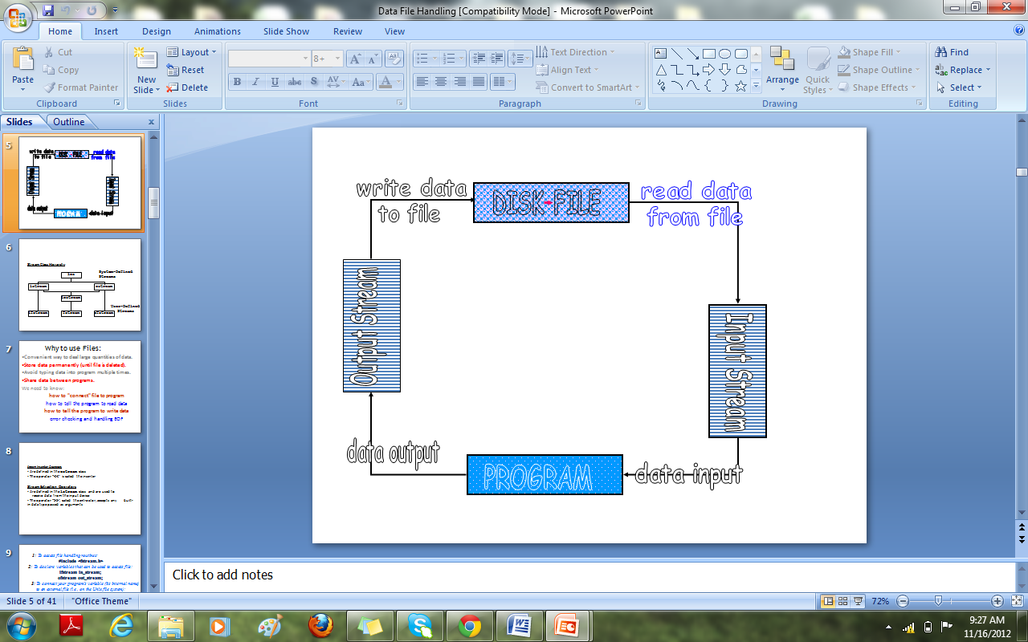
File → Program ( Input stream) - reads
Program → File (Output stream) – write

Slide 6
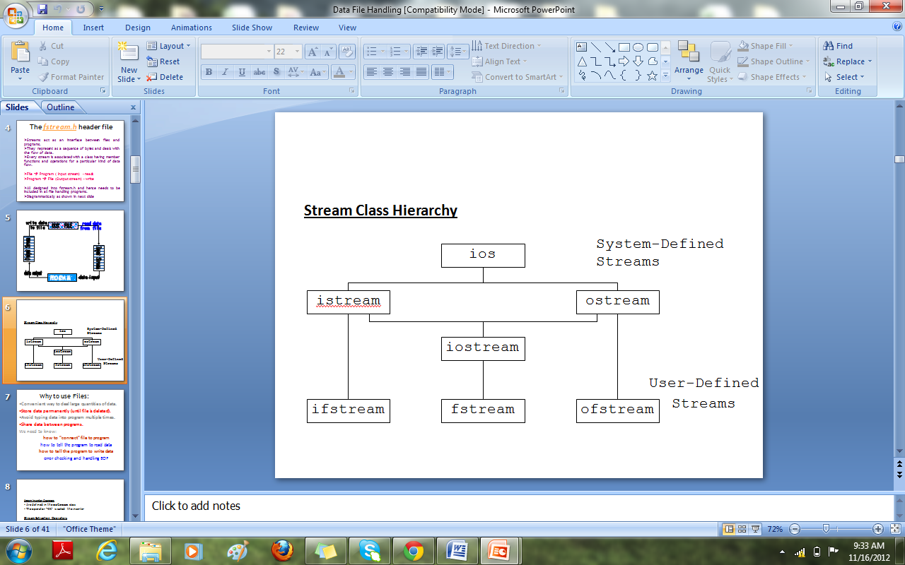
Stream Class Hierarchy

Slide 7
The fstream.h header file
Streams act as an interface between files and programs.
They represent as a sequence of bytes and deals with the flow of data.
Every stream is associated with a class having member functions and operations for a particular kind of data flow.
File → Program ( Input stream) - reads
Program → File (Output stream) – write
All designed into fstream.h and hence needs to be included in all file handling programs.

Slide 8
Why to use Files:
Convenient way to deal large quantities of data.
Store data permanently (until file is deleted).
Avoid typing data into program multiple times.
Share data between programs.
We need to know:
how to "connect" file to program
how to tell the program to read data
how to tell the program to write data
error checking and handling EOF

Slide 9
File Handling Classes
When working with files in C++, the following classes can be used:
  ofstream – writing to a file
  ifstream – reading for a file
  fstream – reading / writing
What does it all have to do with cout?
  When ever we include <iostream.h>, an ostream object, pointing to stdout is automatically defined – this object is cout.
ofstream inherits from the class ostream (standard output class).
ostream overloaded the operator << for standard output.…thus an ofstream object can use methods and operators defined in ostream.

Slide 10
Opening & Closing a File
A file can be open by the method “open()” or immediately in the constructor (the natural and preferred way).
void ofstream / ifstream::open(const char* filename, int mode);
filename – file to open (full path or local)
mode – how to open (1 or more of following – using | )
    ios::app – append
    ios::ate – open with marker at the end of the file
    ios::in / ios::out – (the defaults of ifstream and ofstream)
    ios:nocreate / ios::noreplace – open only if the file exists / doesn’t exist
    ios::trunc – open an empty file
    ios::binary – open a binary file (default is textual)
Don’t forget to close the file using the method “close()”

Slide 11
File Open Modes
ios:: app - (append) write all output to the end of file
ios:: ate - data can be written anywhere in the file
ios:: binary - read/write data in binary format
ios:: in - (input) open a file for input
ios::out - (output) open a file for output
ios:: trunc -(truncate) discard the files’ contents if it exists

Slide 12
A file can be opened in two ways:
Using constructor function
Using member function

Slide 13
Opening file using constructor
File name is used to initialize the file stream object.
Steps:-
Create a file stream object to manage stream with appropriate class.
Initialize the file object with desired name.

Slide 14
Contd……..
ofstream outfile(“results”); //it opens a file name “result” for output.
ifstream infile(“data”);
outfile<<“total”;
outfile.close();
infile>> string;

Slide 15
Opening files using member function open()
This function is used to open multiple files that uses same stream object.
Syntax:-
file_stream class stream_object;
stream_object.open(“filename”);

Slide 16
Example
ofstream outfile;
outfile.open(“Data”);
…………………..
…………………..
outfile.close();
outfile.open(“Data2”);
…………………….
…………………..
outfile.close();

Slide 17
Open(): File Modes
We can have two arguments in open(), to specify the file-mode.
stream-object.open(“filename”,mode);
the second argument specifies the purpose for which file is opened.

Slide 18
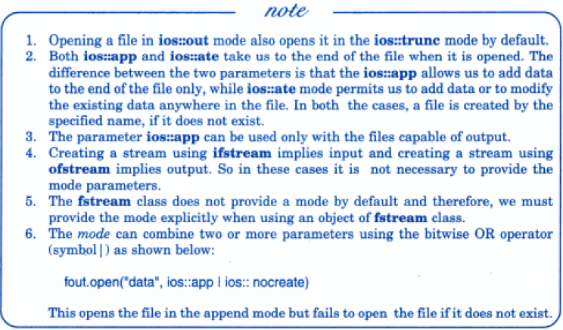


Slide 19
Stream state member functions
In C++, file stream classes inherit a stream state member from the ios class, which gives out the information regarding the status of the stream.
For e.g.:
  eof() –used to check the end of file character
  fail()- used to check the status of file at opening for I/O
  bad()- used to check whether invalid file operations or unrecoverable error .
  good()- used to check whether the previous file operation has been successful

Slide 20
EXAMPLES
EOF()
void main()
{
ifstream infile;
infile.open(“text”);
while(!infile.eof())
{
------
-----
} }

Slide 21
FAIL()
int main()
{
ifstream infile;
infile.open(“text”);
while(!infile.fail())
{
cout<<“cudn’t open a file”;
} }

Slide 22
Reading and Writing in Files
Reading and Writing a character from a file can be done by
Get()
Put()
Get():- This is used to read an alphanumeric character from a specified file.
Put():- This is used to write an alphanumeric character to specified file.

Slide 23
Program to copy contents
#include<iostream>
using namespace std;
#include<fstream>
int main()
{
ofstream out;
char ch;
out.open("hello.txt");
cout<<"enter data";
ch=getche();
while(ch!='.')
{
out.put(ch);
ch=getche();
}
out.close();
cout<<"data saved";
cout<<"contents are";
ifstream infile;
infile.open("hello.txt");
ofstream outfile;
outfile.open("xyz1.txt");
while(!infile.eof())
{
ch=infile.get();
outfile.put(ch);
}
infile.close();
outfile.close();
}

Slide 24
Reading and writing by insertion and extraction
Stream Insertion Operators
Are defined in the ostream class
The operator “<<” is called the inserter
Stream Extraction Operators
Are defined in the istream class and are used to receive data from the input device
The operator “>>”, called the extractor.

Slide 25
Program
#include<iostream>
#include<fstream>
#include<stdlib.h>
using namespace std;
int main()
{ char name[10];
float sal;
ofstream outFile;
outFile.open("Employee1.txt");
if(!outFile)
{ cout<<"\n File could not be opened";
exit(0); }
for(int i=0;i<3;i++) {
cout<<"\nEnter the name and salary"<<i+1<<" : ";
cin>>name>>sal;
outFile<<"\n"<<name<<"\t"<<sal; }
outFile.close();
ifstream inpFile;
inpFile.open("Employee1.txt");
if(!inpFile)
{
cout<<"\n File could not be opened";
exit(0);
}
for(int i=0;i<3;i++)
{
inpFile>>name;
inpFile>>sal;
cout<<"\n Employee"<<i+1<<" : ";
cout<<name<<"\t"<<sal;
}
inpFile.close(); }

Slide 26
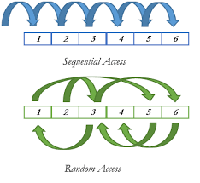
File Access In C++

Slide 27
Sequential Access file operations
A Sequential file has to be Accessed in the same order the file was written. Let's take an example of Cassette Tapes: We play music in the same order it was recorded.
The following member functions are used for reading and writing a character from a specified file.
get()- is used to read an alphanumeric character from a file.
put()- is used to write a character to a specified file or a specified output stream
getline()-reads the character from input stream and puts them in array

Slide 28
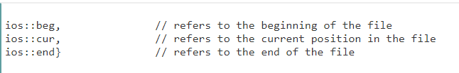
Moving within the File
seekg() / seekp() – moving the reading (get) to a specified location / moves (put) pointer to specified location
  two parameters: offset and anchor
tellg() / tellp() – getting the position of the reading (get) / writing (put) marker

Slide 29
Binary file operations
In connection with a binary file, the file mode must contain the ios::binary mode along with other mode(s)
To read & write a or on to a binary file, as the case may be blocks of data are accessed through the use of C++ read() and write() respectively.

Slide 30
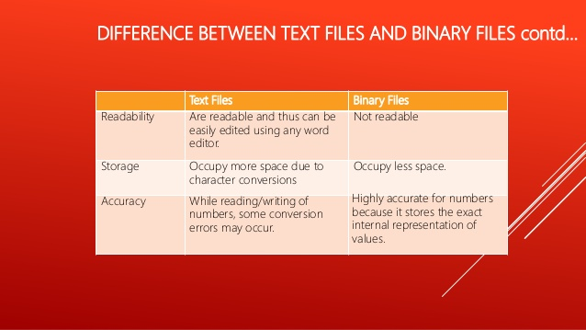
Text files vs Binary files

Slide 31
Reading /Writing from/to Binary Files
The write() function is used to write object or record (sequence of bytes) to the file. A record may be an array, structure or class.
Syntax of write() function
fstream fout;
fout.write( (char *) &obj, sizeof(obj) );
The write() function takes two arguments.
&obj : Initial byte of an object stored in memory.
sizeof(obj) : size of object represents the total number of bytes to be written from initial byte.

Slide 32
The read() function is used to read object (sequence of bytes) to the file.
Syntax of read() function
fstream fin;
fin.read( (char *) &obj, sizeof(obj) );
The read() function takes two arguments:
&obj:Initial byte of an object stored in file.
sizeof(obj) : size of object represents the total number of bytes to be read from initial byte.
The read() function returns NULL if no data read

Slide 33
Reading and writing class object
#include<iostream>
#include<fstream.h>
#include<stdlib.h>
class employee
{
char name[20];
int id;
char dep[20];
public:
void readData();
void writeData();
};
void employee::readData()
{cout<<"\n\nEnter name of the employee";cin>>name;
cout<<"\nEnter ID of the employee";
cin>>id;
cout<<"\nEnter dep of the employee";
cin>>dep;
}
void employee::writeData()
{
cout<<endl<<name<<"whose id is "<<id<<" belongs to department of "<<dep<<endl;
}
int main()
{
employee e[3];
fstream f;
f.open("employeesdata.txt",ios::in|ios::out|ios::app);
cout<<"\nEnter the details of three employees\n";
for(int i=0;i<3;i++)
{
e[i].readData();
f.write((char*)&e[i],sizeof(e[i]));
}
f.seekg(0);
cout<<"\nreading from file";
for(i=0;i<3;i++)
{
f.read((char*)&e[i],sizeof(e[i]));
e[i].writeData();
}
f.close();
getch();
}

Slide 34
Summary
Files in C++ are interpreted as a sequence of bytes stored on some storage media.
Bases classes are used to perform I/O operations.
The data of a file is stored in either readable form or in binary code called as text file or binary file.
The flow of data from any source to a sink is called as a stream.

